Slide 1
El Dorado Hills
Presented by Dan Green
November 6, 2019

Slide 2
Agenda
EDH Overview
Office Market Overview
Office Market Rents
Industrial & Flex Market Fundamentals
Office & Flex Comps
Recent Sales
New Construction
Residential Projects
Marijuana
Conclusion/C&A
Notes:
We

Slide 4
Office Market Fundamentals

Slide 5
Office Market Rents

Slide 6
Industrial/Flex Market Fundamentals

Slide 7
Recent Office Lease Comps
Tenant | Property | SF | Sign Date | Commencement | Expiration | Lease Terms
SlideBelts | 5272 RJM | 58,000 | May 2018 | June 2018 | Feb. 2024 | $0.17/SF NNN, tenant in tow
Dignity Health | 1264 Hawks Flight Ct | 14,999 | Aug. 2019 | June 2020 | May 2030 | $2.13/SF FSG, expansion/relocation
Raytheon | 5180 GFP | 14,424 | Sept. 2018 | December 2018 | Nov. 2023 | $2.07/SF FSG
Keeper Security | 5180 GFP | 12,191 | March 2019 | August 2019 | July 2024 | $1.85/SF FSG
Rising Sun Montessori School | 4940-4958 RJM | 11,200 | March 2019 | June 2019 | May 2029 | Last minute relocation, office/retail space
RCP Construction | 5180 GFP | 5,567 | Dec. 2018 | December 2018 | January 2022 | $1.65/SF FSG
iHeart Media | 5180 RJM | 4,362 | Sept. 2019 | January 2020 | June 2027 | $1.80/SF FSG

Slide 8
Recent Industrial/Flex Lease Comps
Tenant | Property | SF | Sign Date | Commencement | Expiration | Lease Terms
H2O, LLC | 5000 RJM | 31,200 | Feb. 2019 | July 2019 | June 2024 | $0.75/SF NNN starting
Bios Fitness and Nutrition | 4911 Windplay | 5,000 | Jan. 2019 | April 2019 | May 2023 | $0.65/SF NNN
Next Level Academy | 4990 Hillsdale | 3,100 | Jan. 2019 | January 2019 | December 2021 | $0.90/SF NNN
Kaia Fit | 4511 GFP | 3,481 | August 2019 | October 2019 | Sept. 2024 | $1.30/SF MG
Explorer Pest Management | 4511 GFP | 3,070 | Sept. 2019 | October 2019 | Sept. 2024 | $1.15/SF MG
Kenneth Development | 4511 GFP | 2,028 | July 2019 | September 2019 | August 2024 | $1.66/SF MG

Slide 9
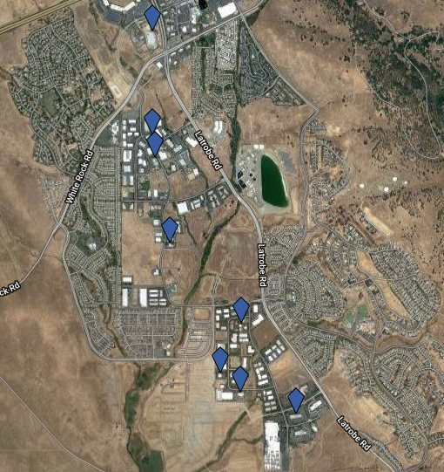
Recent Sales
Property | Sale Price | Price/SF | Buyer
1101-1107 Investment Blvd | $17.8M | $132 | SUM Bible College
1100 Investment Blvd | $10.6M | $148 | Nady Trust
1102 Investment Blvd | $8.5M | $120 | John Adams Academy
5152 Hillsdale Cir | $6.75M | $386 | Mark Kable, Laura Trussell
5137 Golden Foothill Pkwy | $6.6M | $199 | Leo Arnaudo, Martin Enos
5072 Hillsdale Cir | $3.2M | $155 | El Dorado County
4800 Golden Foothill Pkwy | $2.8M | $151 | Denise Degroff

Slide 10
Properties on the Market
Property | Type | Price / Price per SF | Bldg. SF
4250 Town Center Blvd | Manufacturing | $10M / $112 | 89,000
4805 Golden Foothill Pkwy | Office | $5M / $310 | 16,125
3921 Sandstone Dr | Warehouse | $3.9M / $135 | 28,800
1235 Glenhaven Ct | Flex | $3.5M / $151 | 23,520
1108 Investment Blvd | Office | $3.4M / $194 | 17,603
4987 Golden Foothill Pkwy | Medical Office | $2.4M / $300 | 8,000
4661 Golden Foothill Pkwy | Flex Condos | $1.76M / $150 | 11,778

Slide 11
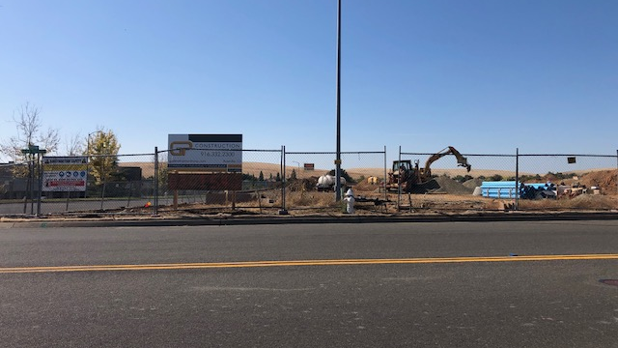
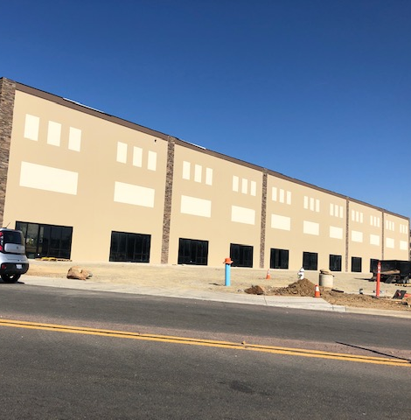
New Commercial Construction

Slide 12
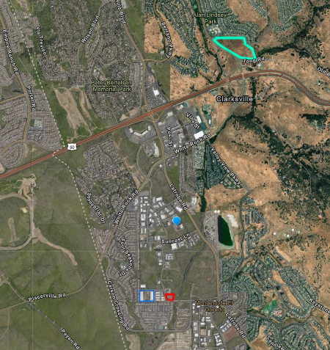
New Commercial Construction
Sandstone Drive New school proposed
Emed Technologies 30,000 SF office
Q4 2019 completion
75K SF Aerometals expansion, 2017 completion
Cobabe Plumbing 28,601 SF flex + 6,000 SF office under construction

Slide 13
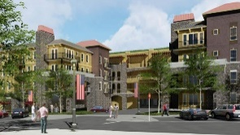
Residential Development
Town Center Apartments
Notes:
El Dorado Hills continues to see significant levels of new home construction. In addition to hundreds of new single family homes from Lennar, Taylor Morrison, and Toll Brothers, AG Spanos Companies broke ground on its 214-unit apartment project at Town Center this summer, and senior living developers like Oakmont Senior Living continue to bring new projects to the market along Latrobe.
El Dorado County's population increased by 1.3% (+2,437 residents) from July 2017 to July 2018, according to the CA Department of Finance.
Folsom Ranch at full build out will have 11,000 homes and 25,000 new residents.

Slide 14
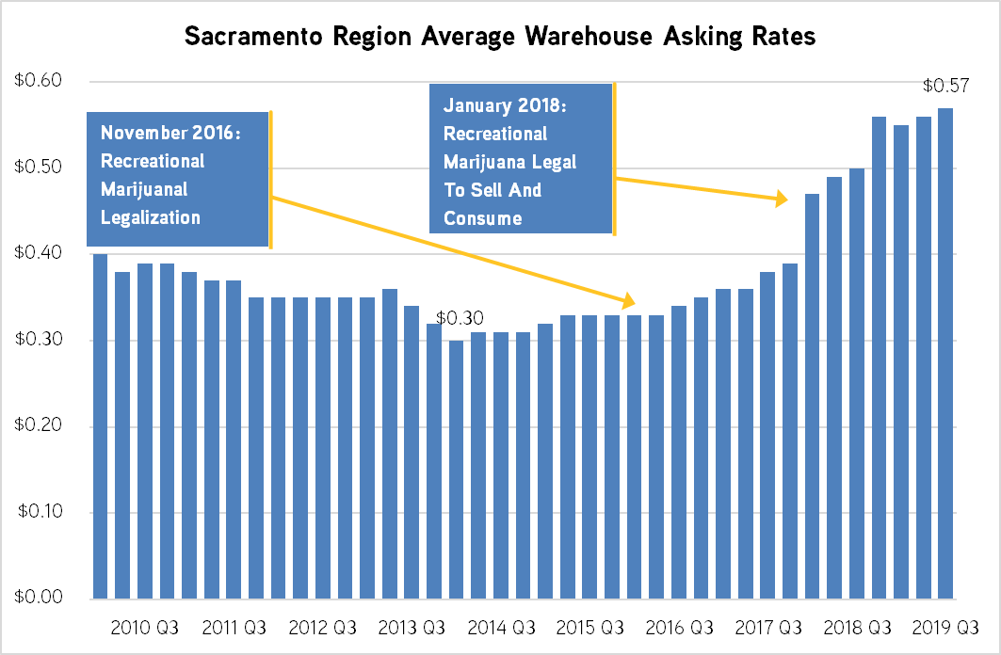
Cannabis – Sacramento Rent Impact
Notes:
Industrial asking rates have doubled over the last five years and have spiked significantly since the legalization of marijuana
El Dorado County voters approved five ballot measures legalizing the cultivation and sale of commercial marijuana last November. All five measures addressing commercial cultivation and sale/taxing of marijuana passed by wide margins.
The new measures allow the issuance of 150 cultivation sites in rural and agricultural areas, in addition to seven permits for recreational and medical dispensaries.
El Dorado will be one of the first counties in Sacramento to allow commercial cannabis sales and cultivation. All commercial cannabis activity is banned in Placer County and unincorporated parts of Sacramento County, while only medicinal cannabis can be grown in unincorporated Yolo County and no dispensaries are allowed.
Dispensaries could be taxed between 4 and 10 percent and cultivators could be taxed up to $30/SF of growing space or up to 15 percent of total gross receipts. The county could receive up to $52.8 million per year, according to the county's voter guide.
In September 2019, the El Dorado County Board of Supervisors decided to tax retail at 4% of gross receipts, outdoor cultivation $2 per square foot, mixed-light cultivation $4 per square foot, indoor cultivation $7 per square foot, manufacturing 2.5% of gross receipts, distributor transport 2% of gross receipts, testing at 0.5% of gross receipts and nurseries at 4% of gross receipts.

Slide 15
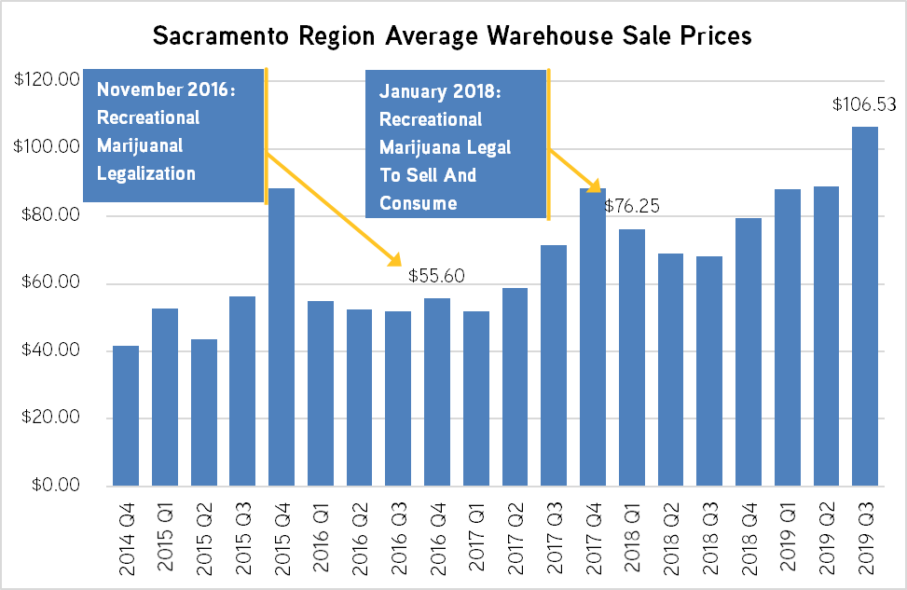
Cannabis – Sacramento Sales Impact
+40%
Q1 2018 vs. Q3 2019

Slide 16
Cannabis Coming to El Dorado County
TODAY:
El Dorado County accepting permits for retail, delivery, distribution, and cultivation
September 2019:
El Dorado County Board of Supervisors finalizes tax structure for commercial cannabis
November 2018:
El Dorado County voters legalize cultivation and sale of commercial marijuana
December 2016: Statewide Measure (Prop 64) Passes, Lost by 123 Votes in El Dorado County
Notes:
El Dorado County voters approved five ballot measures legalizing the cultivation and sale of commercial marijuana last November. All five measures addressing commercial cultivation and sale/taxing of marijuana passed by wide margins.
The new measures allow the issuance of 150 cultivation sites in rural and agricultural areas, in addition to seven permits for recreational and medical dispensaries.
El Dorado will be one of the first counties in Sacramento to allow commercial cannabis sales and cultivation. All commercial cannabis activity is banned in Placer County and unincorporated parts of Sacramento County, while only medicinal cannabis can be grown in unincorporated Yolo County and no dispensaries are allowed.
Dispensaries could be taxed between 4 and 10 percent and cultivators could be taxed up to $30/SF of growing space or up to 15 percent of total gross receipts. The county could receive up to $52.8 million per year, according to the county's voter guide.
In September 2019, the El Dorado County Board of Supervisors decided to tax retail at 4% of gross receipts, outdoor cultivation $2 per square foot, mixed-light cultivation $4 per square foot, indoor cultivation $7 per square foot, manufacturing 2.5% of gross receipts, distributor transport 2% of gross receipts, testing at 0.5% of gross receipts and nurseries at 4% of gross receipts.

Slide 17
Colliers EDH Market Summary
Vacancy Rates Dropping
Rents on the Rise
New Construction – Owner Users
Look for Residential and Cannabis to further tighten the market.

Slide 18
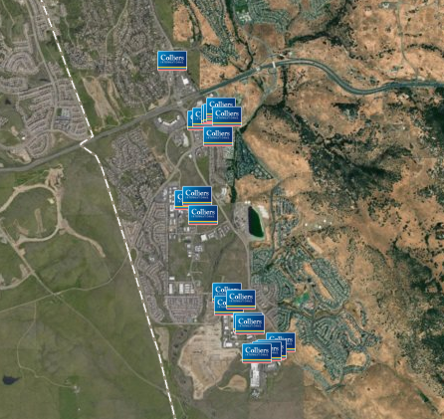
Colliers Market Share in El Dorado Hills
Notes:
As of mid-October 2019:
10 office bldgs = 513K SF
8 flex/industrial bldgs = 122K SF
8 retail bldgs = 98K SF

Slide 19
Q & A
ANY QUESTIONS?

